Slide 1
Host Context Working Group
Bryan Bartley, Michal Galdzicki
Newcastle University
4/24/2013

Slide 2
Examples
- Canonical synbio (Repressilator)
- Cell-free synthetic biology
- Multi-cellular (CoSMO)
Proposed: “Context” Object Model

Slide 3
A Hierarchy of Contexts Must be Specified for Proper Function
Measurement
Device
Environment
Container
Context: What is needed to reproduce the intended function of a DNA design
Medium
Host
Composition

Slide 4
A Hierarchy of Contexts Must be Specified for Proper Function
Measurement
Device
Environment
Container
Context: What is needed to reproduce the intended function of a DNA design
Medium
Host
DNA Component class is good at specifying some elements of composition but is still limited.
Composition

Slide 5
A Hierarchy of Contexts Must be Specified for Proper Function
Measurement
Device
Environment
Container
Context: What is needed to reproduce the intended function of a DNA design
Medium
Cardinale S and Arkin AP. Contextualizing context for synthetic biology – identifying causes of failure of synthetic biological systems. Biotechnol J. 2012 July; 7(7): 856–866.
Host
Composition

Slide 6
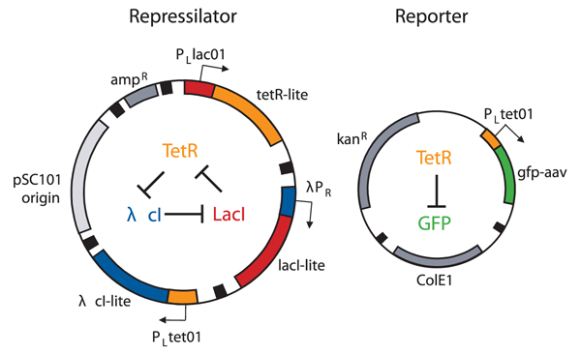
Canonical EX: Repressilator
Elowitz MB, Leibler S. A synthetic oscillatory network of transcriptional regulators. Nature. 2000 Jan 20;403(6767):335-8.
Notes:
Host cell contains a genome, 2 plasmids, a lacI deficient host is required
Needs: To reproduce the design / to reproduce the function
Why is needed:
Potentially different copy #’s or oriR’s
Specific host type
Plasmids need circularity for plasmid replication

Slide 7
Canonical EX: Repressilator
Measurement Device
Environment
Container
Medium
Host
Composition
Zeiss Axiovert 135TV microscope
The temperature of the samples was maintained at 30–32 °C by using Peltier devices (Melcor)
coverslip and microscope slide
minimal media
1 ml of liquid 2% SeaPlaque low-melt agarose (FMC) in media
100 uM IPTG inducer
antibiotic 20 g ml-1 kanamycin or 20 g ml -1 ampicillin)
minimum initial cell density OD = 0.1
E. coli lac- strain MC4100
Genome, Repressilator and Reporter plasmids
Notes:
Host cell contains a genome, 2 plasmids, a lacI deficient host is required
Needs: To reproduce the design / to reproduce the function
Why is needed:
Potentially different copy #’s or oriR’s
Specific host type
Plasmids need circularity for plasmid replication

Slide 8
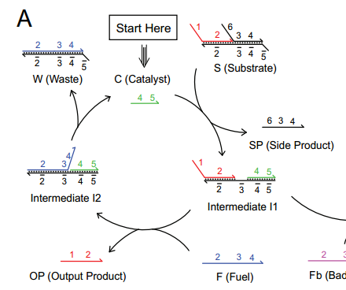
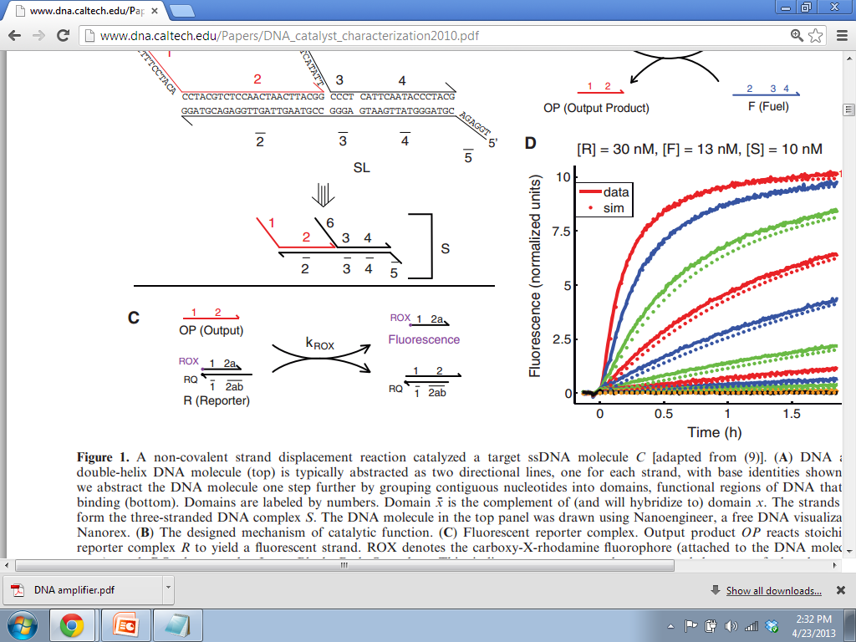
Cell-free synthetic biology EX: DNA amplifier
Zhang DY, Winfree E. Robustness and Modularity Properties of a Non-covalent DNA Catalytic Reaction. Nuc. Acids Res. 38: 4182-4197 (2010)
Notes:
Host cell contains a genome, 2 plasmids, a lacI deficient host is required
Needs: To reproduce the design / to reproduce the function
Why is needed:
Potentially different copy #’s or oriR’s
Specific host type
Plasmids need circularity for plasmid replication

Slide 9
Cell-free synthetic biology EX: DNA amplifier
Measurement Device
Environment
Container
Medium
Host
Composition
Spectroﬂuorimetry studies were done using a SPEX
Fluorolog-3 (Horiba)
25C
1.6 ml synthetic quartz cells
(Hellma catalog number 119-004F)
TE (10 mM Tris–HCl, pH balanced to 8.0, 1 mM EDTA) with 12.5 mM MgCl2 added.
none
fuel, catalyst, reporter strands, etc.
Notes:
Host cell contains a genome, 2 plasmids, a lacI deficient host is required
Needs: To reproduce the design / to reproduce the function
Why is needed:
Potentially different copy #’s or oriR’s
Specific host type
Plasmids need circularity for plasmid replication

Slide 10
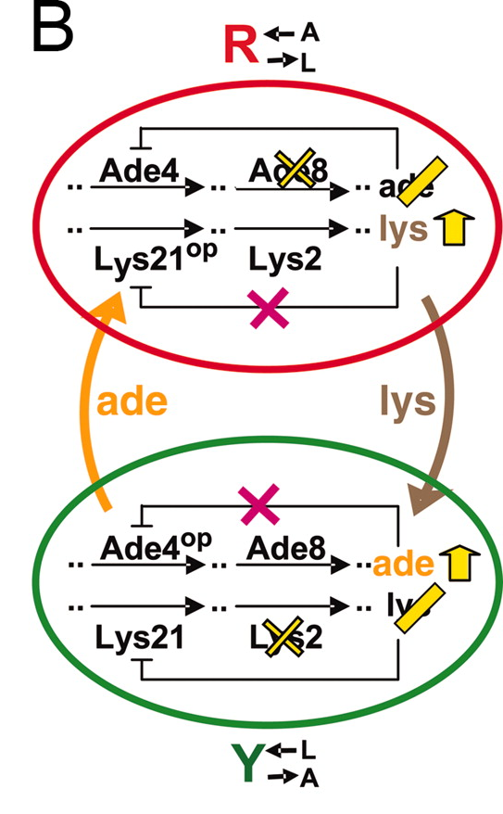
Multicellular synbio EX: CoSMO
Shou W, Ram S, Vilar JM. Synthetic cooperation in engineered yeast populations.Proc Natl Acad Sci U S A. 2007 Feb 6;104(6):1877-82.
Notes:
Two distinct strains, same container. Distinct populations interacting thru media
Regulatory relationships between the two strains
Output/Input

Slide 11
Multicellular synbio EX: CoSMO
Measurement Device
Environment
Container
Medium
Host
Composition
FACS Calibur (BD Biosciences)
Not specified
Not specified
SD minimal media lacking lysine and adenine
minimum initial cell density of both strains
2 independent genomes
S. cerevisiae strains WY811 and WY833
Notes:
Host cell contains a genome, 2 plasmids, a lacI deficient host is required
Needs: To reproduce the design / to reproduce the function
Why is needed:
Potentially different copy #’s or oriR’s
Specific host type
Plasmids need circularity for plasmid replication

Slide 12
Proposed “Context” Class
Context
- uri[1]: URI()
- displayID[1]: string()
- name[0..1]: string()
- description[0..1]: string()
type[0..*]: URI()
sourceURI[1]: URI()
specifies level in the contextual hierarchy: host, container, environment, etc
sourceURI points to local repo, online repo (eg, CGSC) , or vendor
- subComponent
DNA component
[0..*]

Slide 13
Repressilator
Context
type: host
Name: E. coli MC4100
DNA component
Name: MC4100 genome
DNA component
Name: reporter plasmid
DNA component
Name: Repressilator plasmid

Slide 14
DNA Amplifier
Context
Type: media
Name: TE buffer
DNA component
Name: reporter
DNA component
Name: Catalyst
DNA component
Name: Fuel

Slide 15
CoSMO
Context
Type: media
Name: SD minimal
Context
Type: Host
Name: WY811
Context
Type: Host
Name: WY811
DNA component
Name: WY811 genome
DNA component
Name: WY833 genome

Slide 16
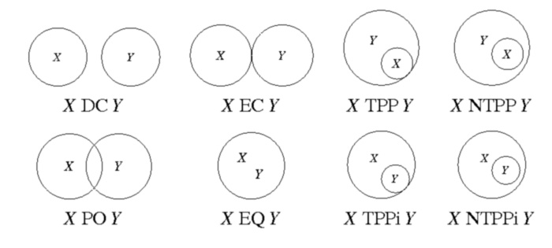
Regional Connection Calculus
disconnected (DC)
externally connected (EC)
equal (EQ)
partially overlapping (PO)
tangential proper part (TPP)
tangential proper part inverse (TPPi)
non-tangential proper part (NTPP)
non-tangential proper part inverse (NTPPi)

Slide 17
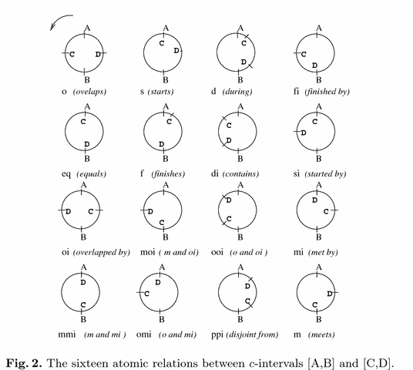
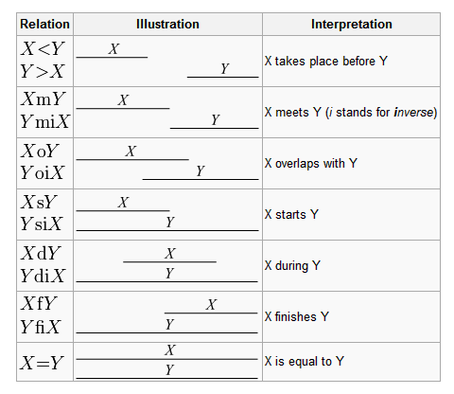
Allen’s Linear Interval Algebra
Cyclic Interval Algebra
Osmoni, Aomar. Introduction to Reasoning about Cyclic Intervals.

